Slide 1



Exam 2 Data Analytic
MentorShip

Slide 2
1. Topic 2. Layout 3. Scope

Slide 3
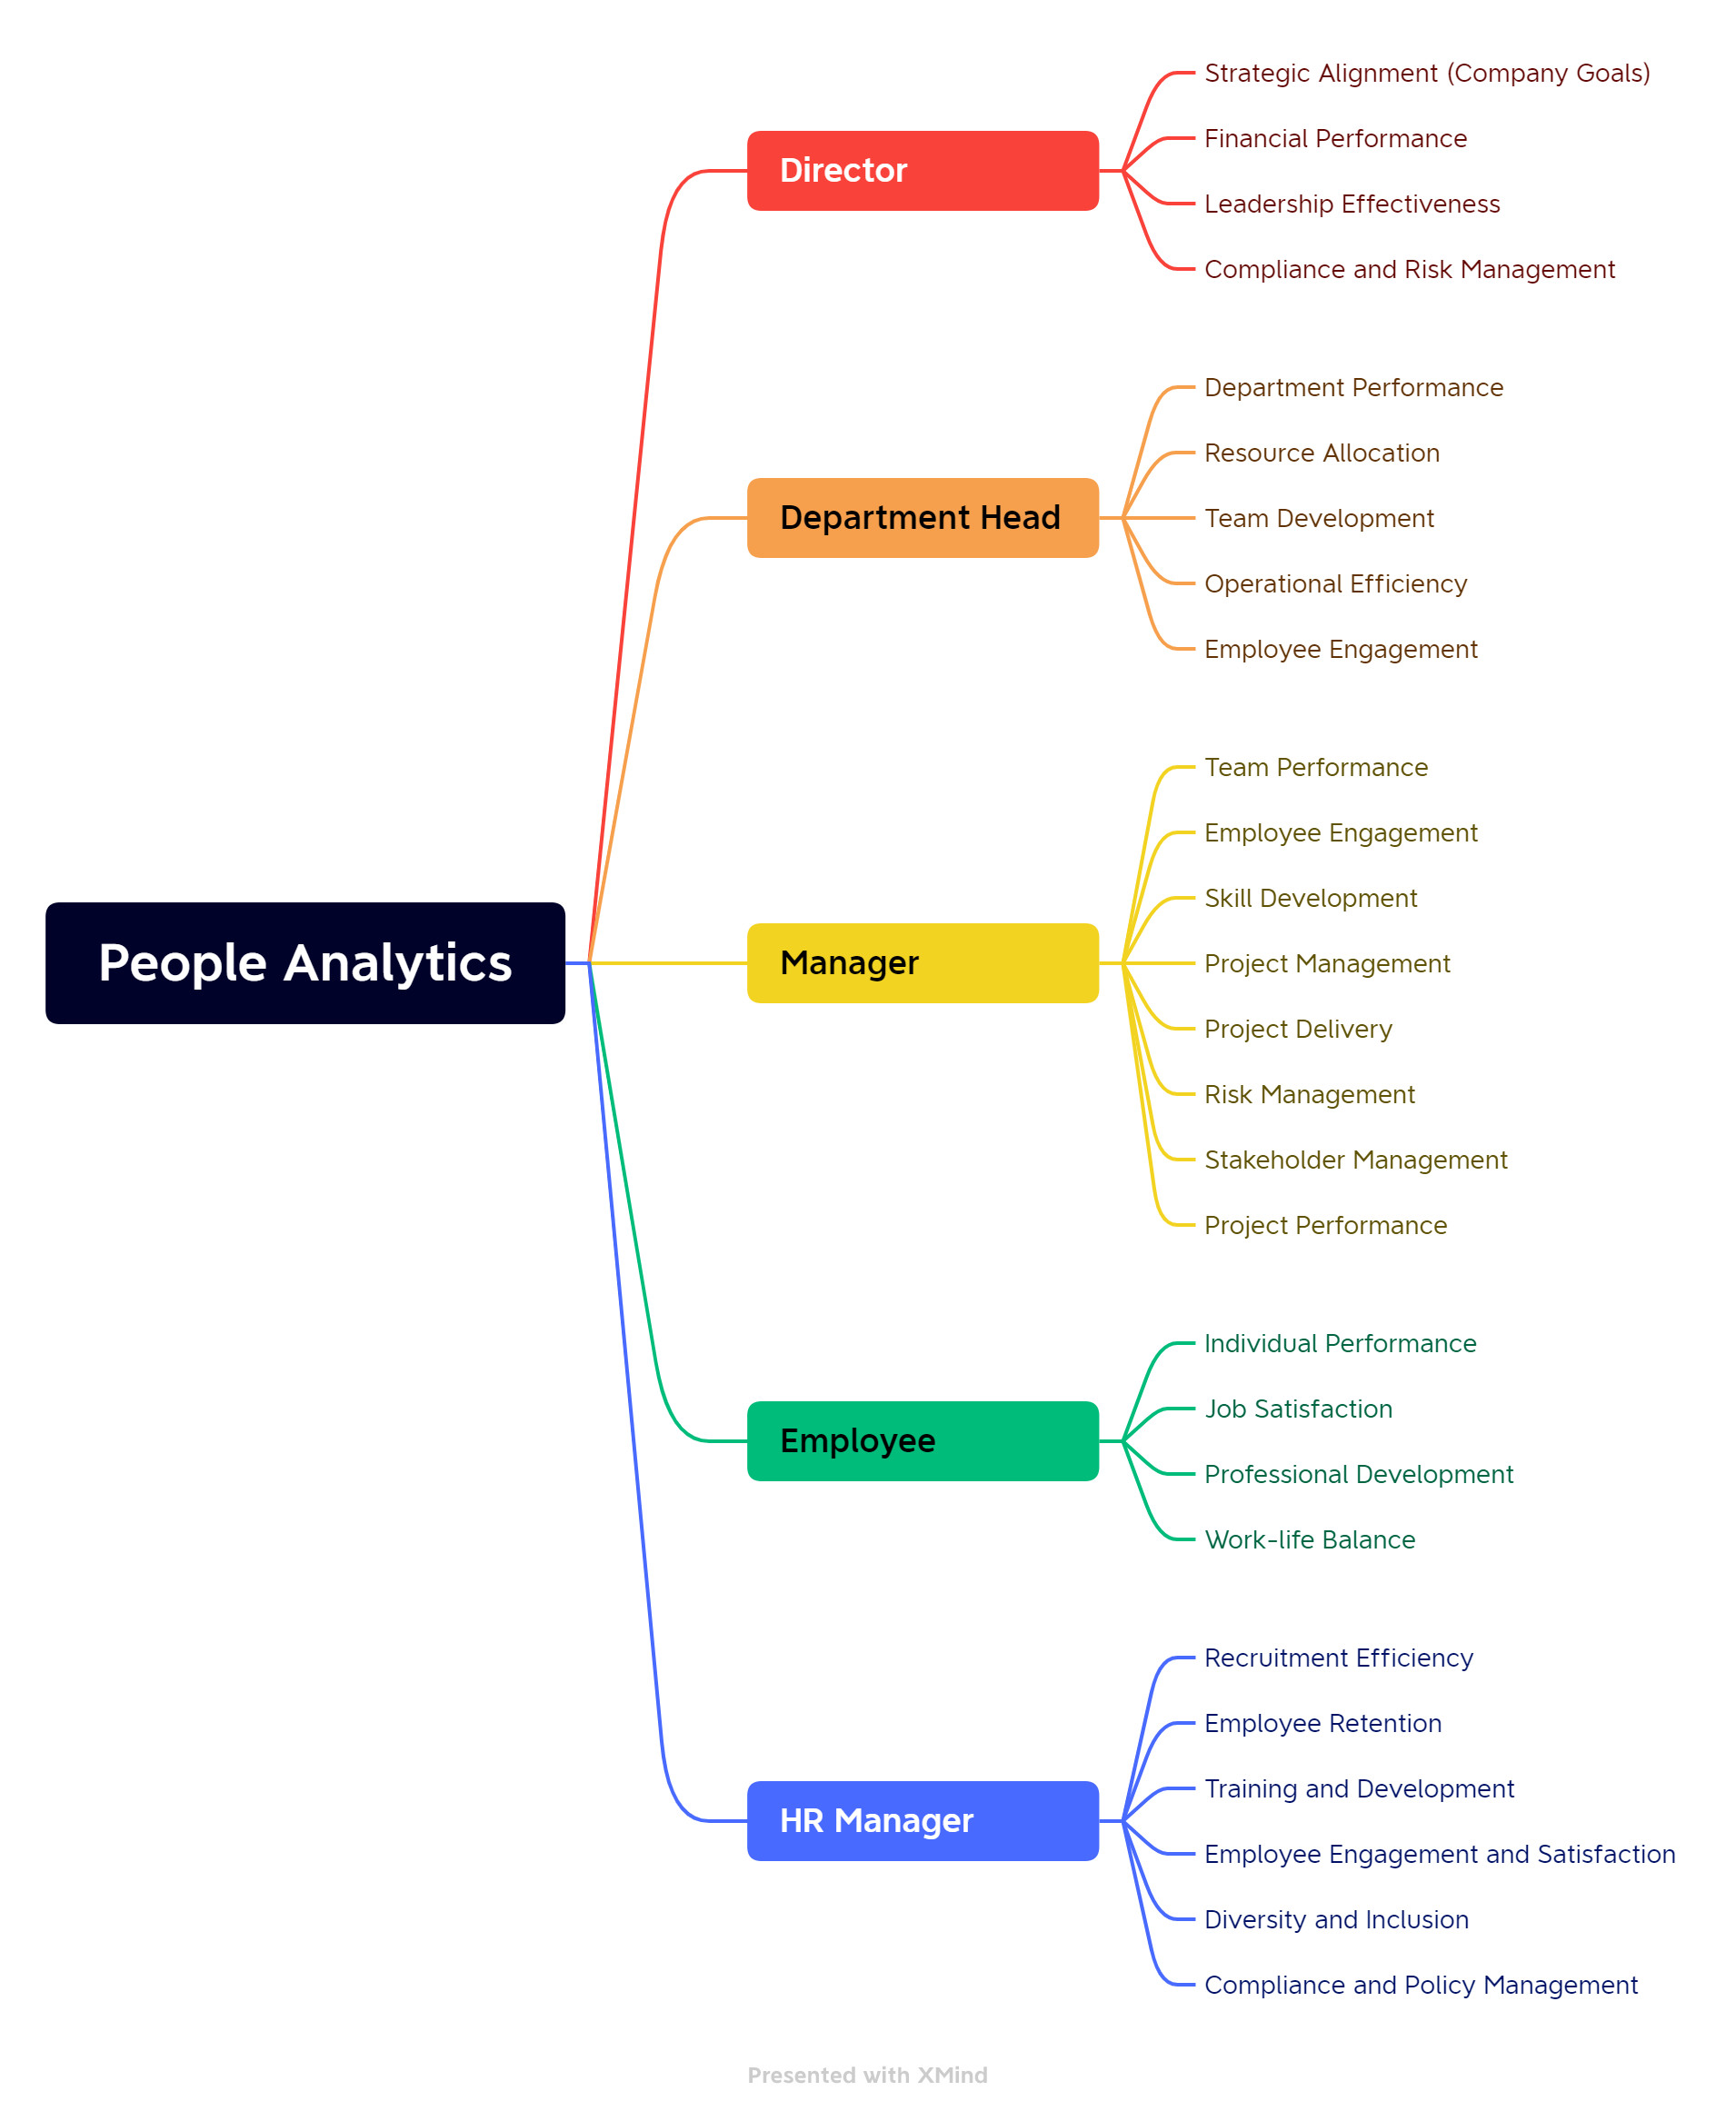
1. Topic
Role:
Director
Department Head
Department Head
Department Head
HR Manager

Slide 4

1. Topic
Layouts need to be displayed:
Summary: Total number of employees, Total number of departments, Total number of positions
Diversity: Gender ratio, Diversity index
Historical & Trend: Recruitment trend, Resignation trend
Employee Details: Name, Position, Department, Date of joining
Salary Analysis: Average salary, Salary distribution
Demography: Age distribution, Gender distribution
Performance Analysis: Average performance rating, Performance distribution
Training: Total number of training hours, Distribution of training hours
Leave Analysis: Total number of leave days, Leave days distribution
Absenteeism: Total number of absence days, Absence distribution
Termination Analysis: Total number of resignations, Reasons for resignation
Attrition Analysis: Attrition rate, Attrition trend
Attrition Prediction: Predicted attrition rate, Influencing factors
Employee Attrition: List of employees with attrition, Reasons for attrition.

Slide 5
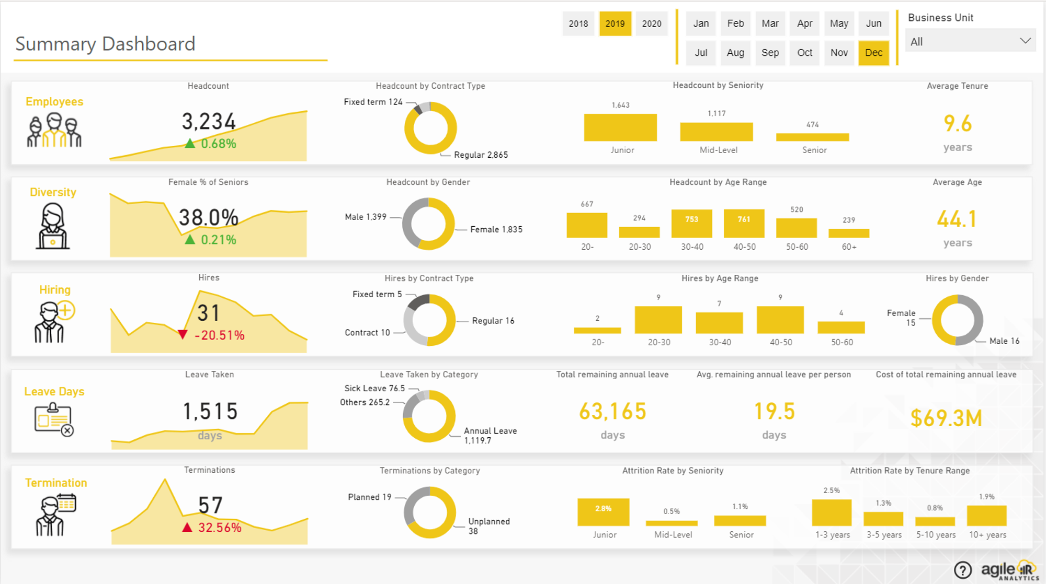
2.Layout
Summary:
This layout provides a quick overview of the employee structure within the organization. It displays the total number of employees, total number of departments, and total number of positions. This information can give a snapshot of the size and structure of the organization.

Slide 6
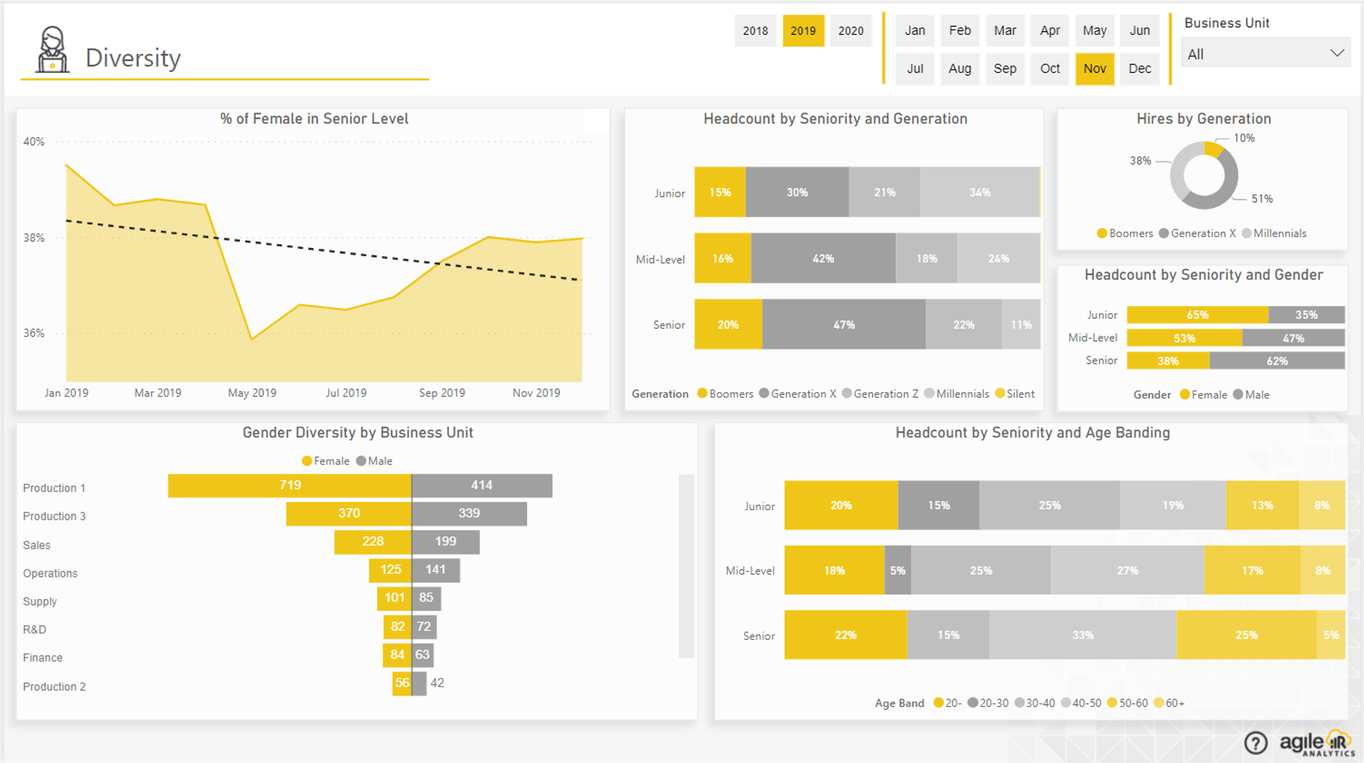
2.Layout
Diversity:
This layout focuses on the diversity within the organization. It displays the gender ratio and diversity index. This information can provide insights into the gender balance within the organization and the level of diversity.

Slide 7
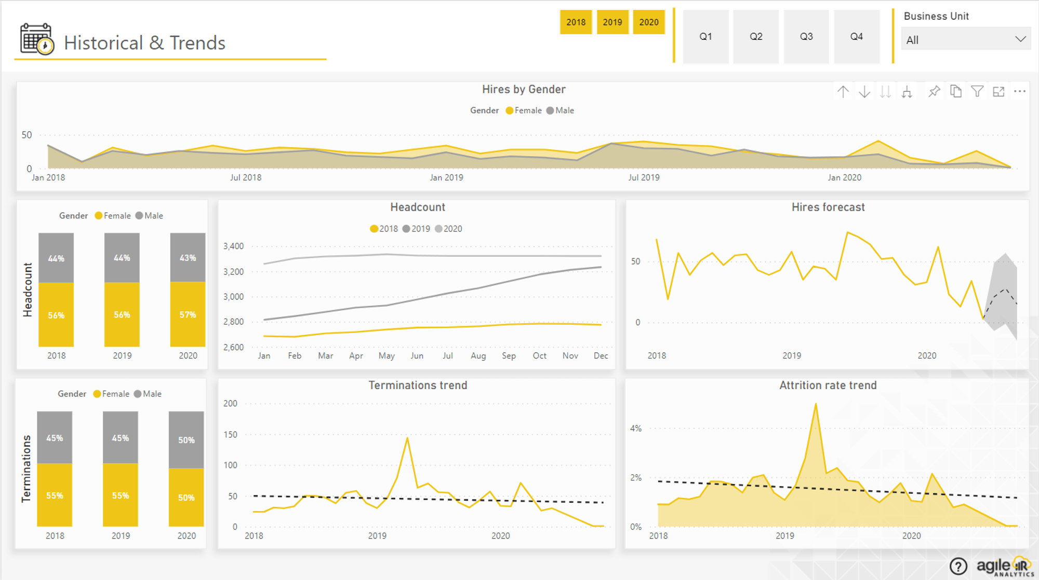
2.Layout
Historical & Trends: This layout shows the recruitment trend and the trend of employees leaving the organization. This information can provide insights into the hiring and turnover patterns over time.

Slide 8
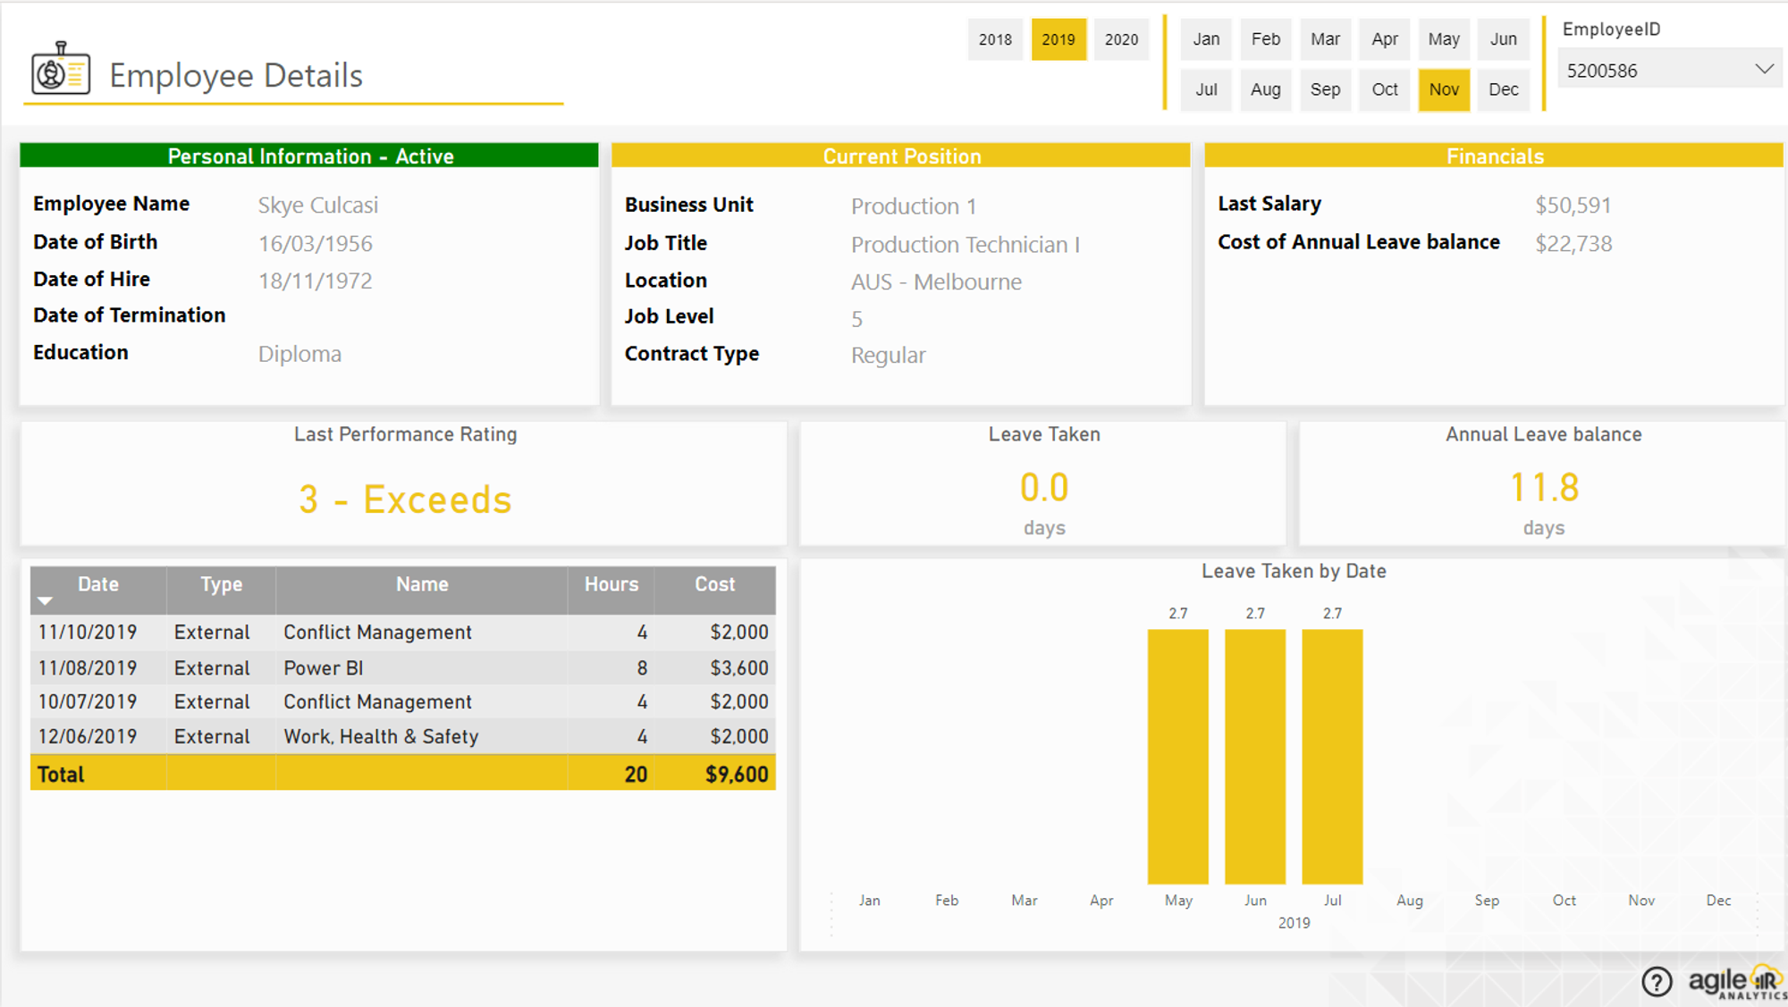
2.Layout
Employee Details:
This layout provides detailed information about each employee, including their name, position, department, and date of employment. This information can be useful for understanding the background and role of each employee within the organization.

Slide 9
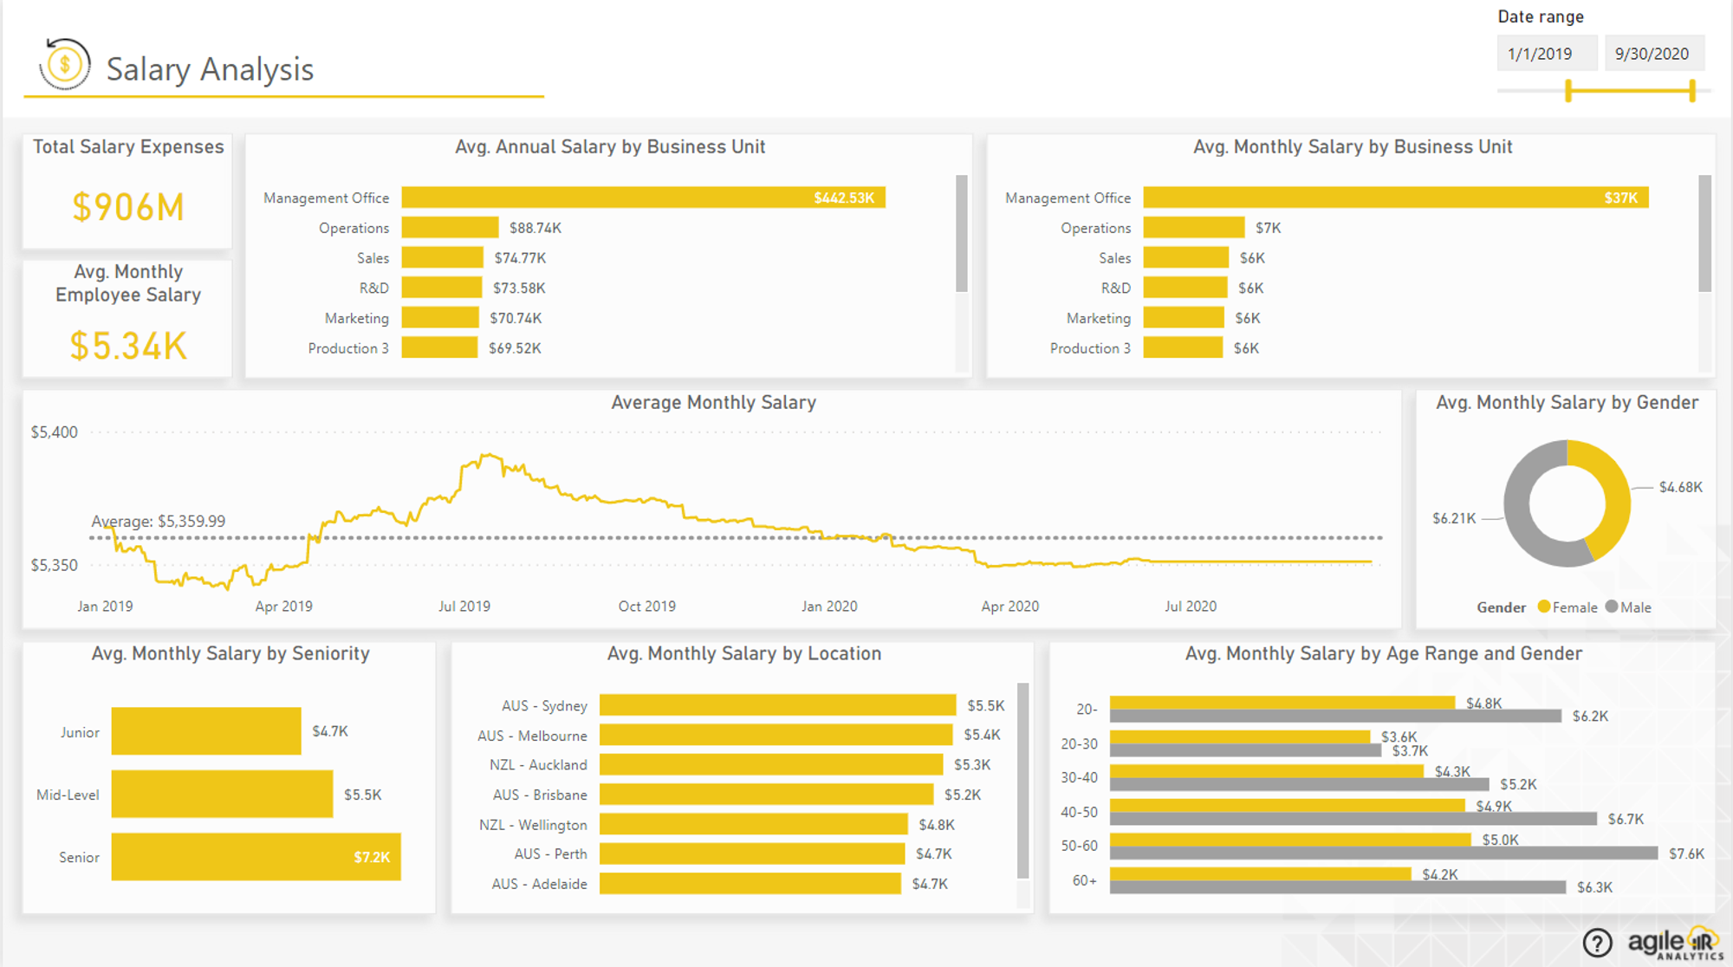
2.Layout
Salary Analysis:
This layout shows the average salary and salary distribution. This information can provide insights into the compensation structure within the organization, including the average salary and how salaries are distributed among employees.

Slide 10
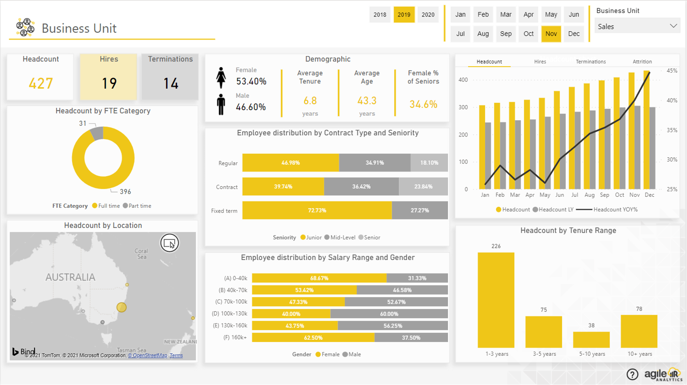
2.Layout
Demography:
This layout shows the age and gender distribution of employees. This information can provide insights into the demographic makeup of the organization's workforce.

Slide 11
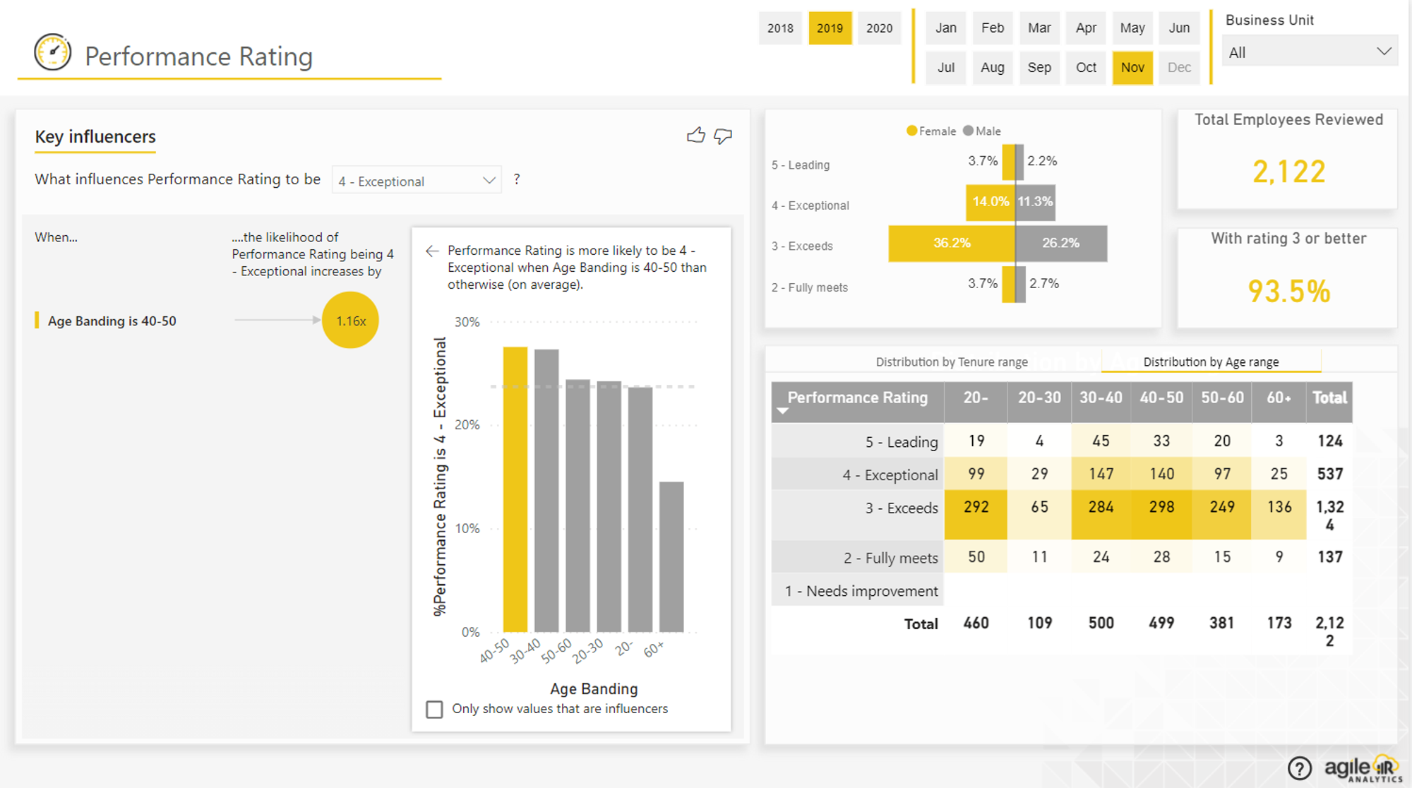
2.Layout
Performance Analysis:
This layout shows the average performance rating and the distribution of performance ratings. This information can provide insights into the performance levels within the organization, including the average performance and how performance varies among employees.

Slide 12
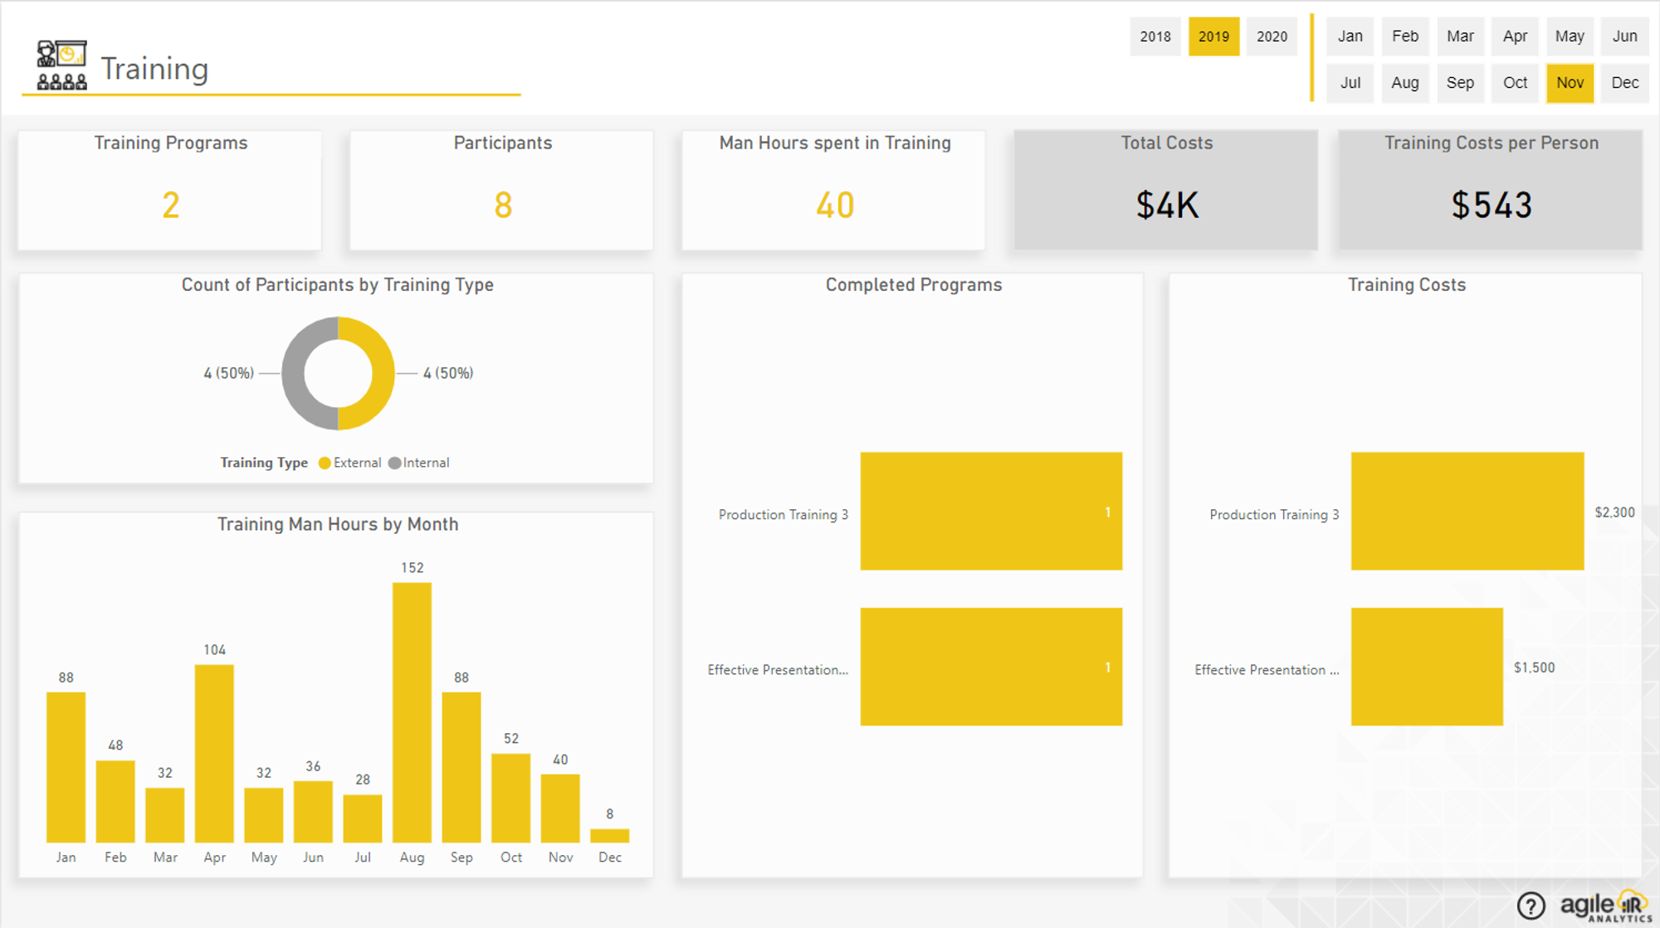
2.Layout
Training:
This layout shows the total training hours and the distribution of training hours. This information can provide insights into the organization's training programs, including the total amount of training provided and how training hours are distributed among employees.

Slide 13
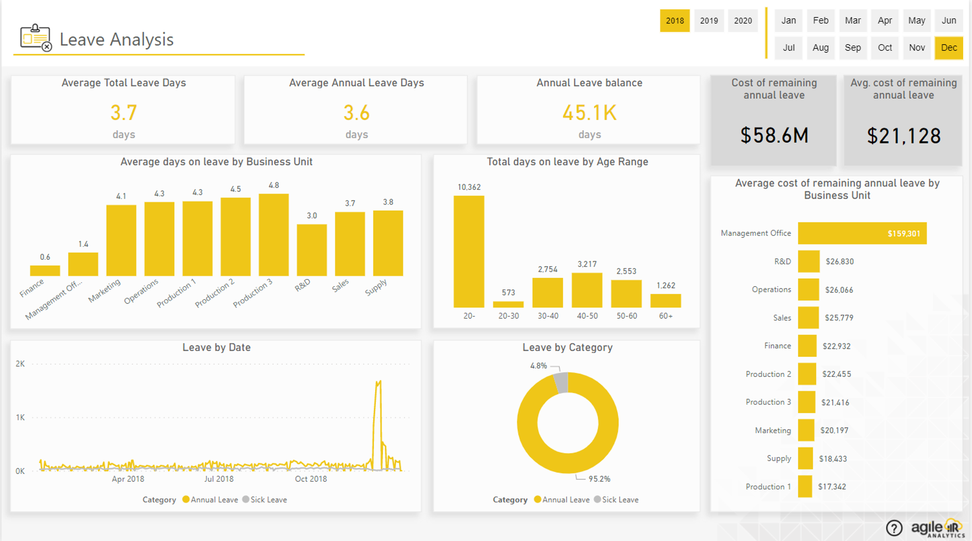
2.Layout
Leave Analysis:
This layout shows the total number of leave days and the distribution of leave days. This information can provide insights into leave patterns within the organization, including the total amount of leave taken and how leave days are distributed among employees.

Slide 14
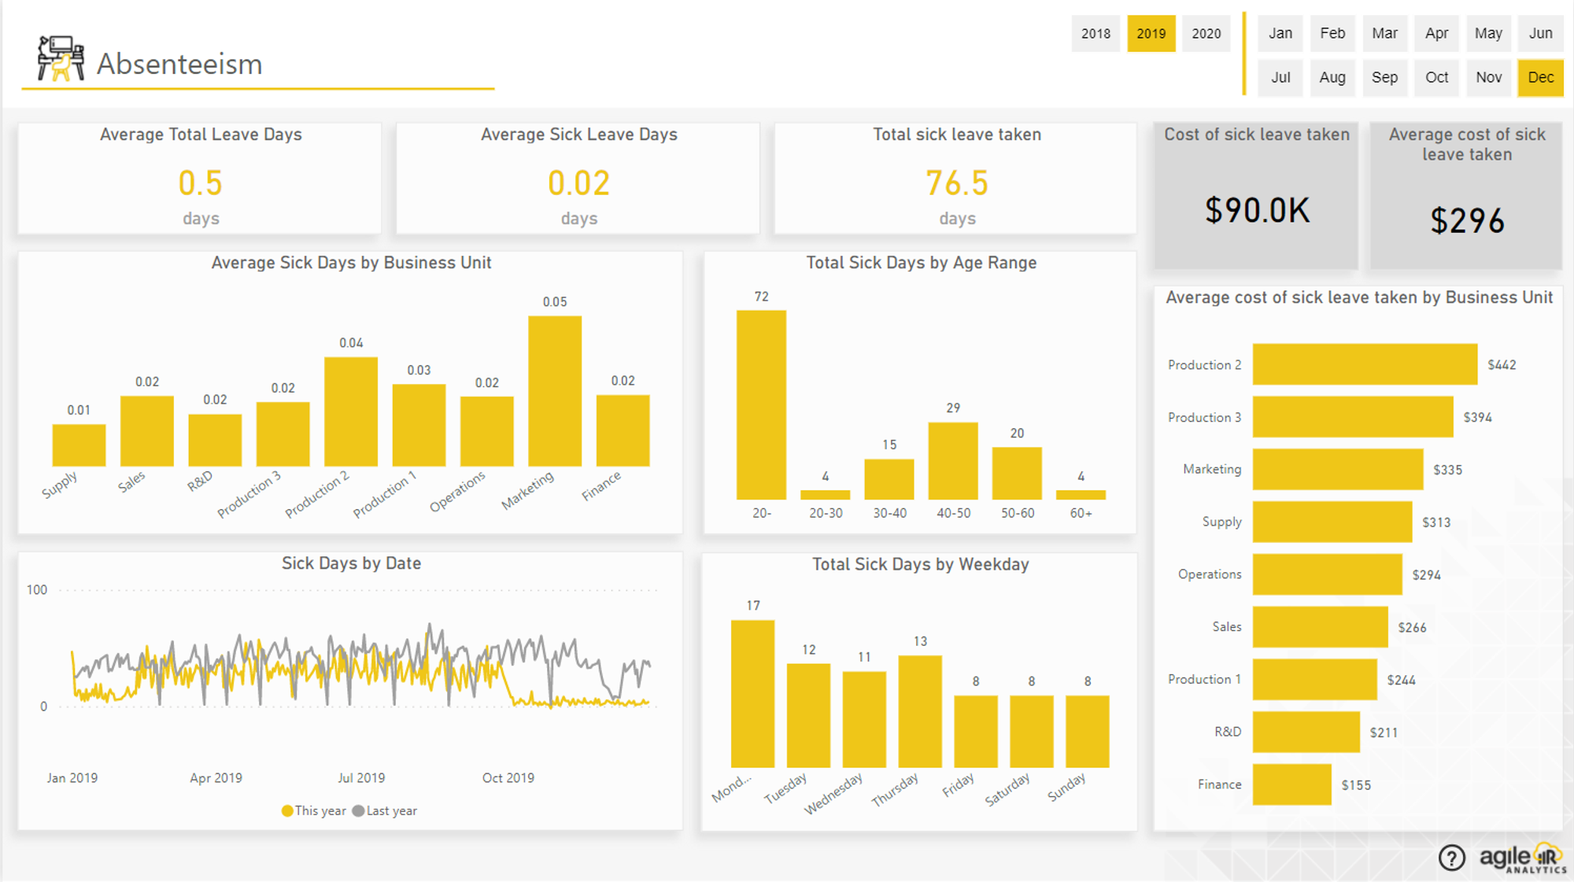
2.Layout
Absenteeism:
This layout shows the total number of absenteeism days and the distribution of absenteeism days. This information can provide insights into absenteeism patterns within the organization, including the total amount of absenteeism and how absenteeism varies among employees.

Slide 15
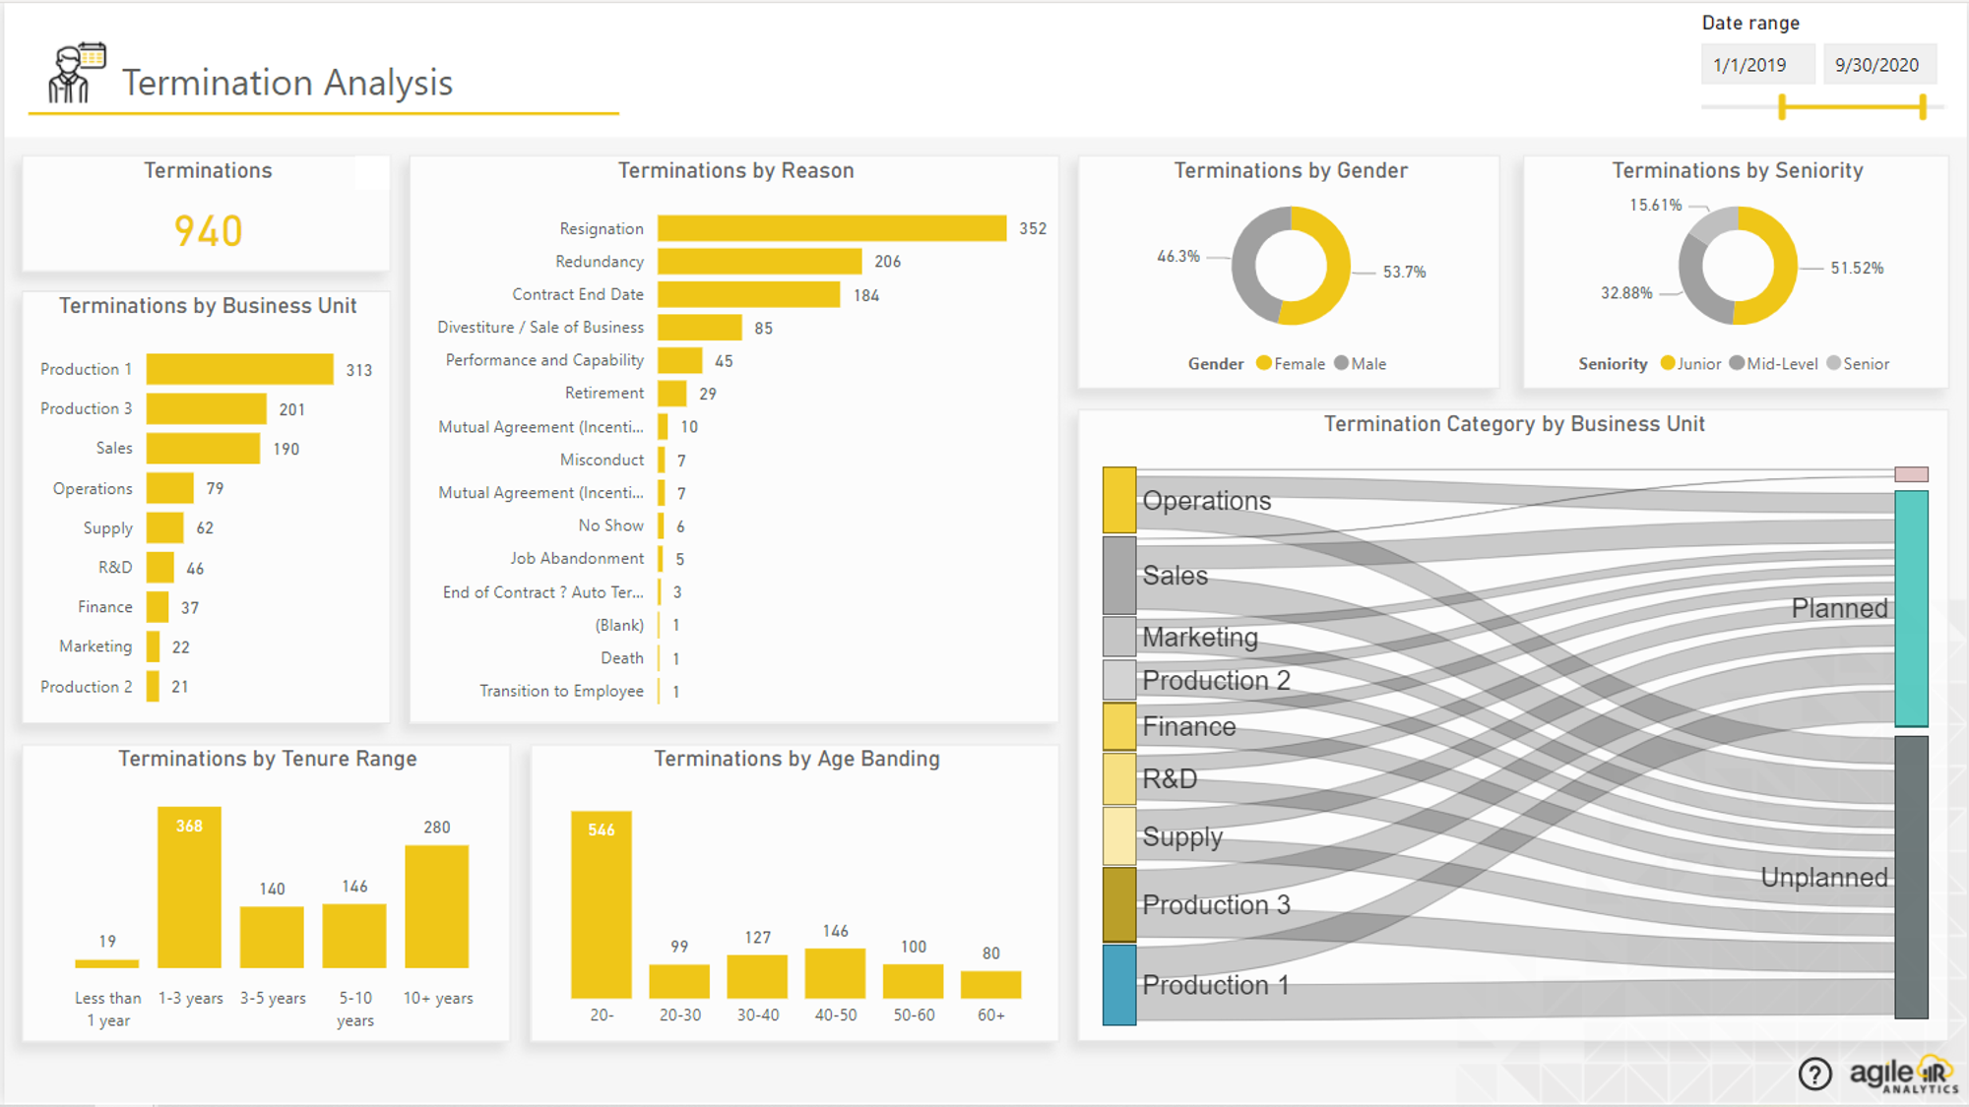
2.Layout
Termination Analysis:
This layout shows the total number of terminations and the reasons for termination. This information can provide insights into the reasons why employees are leaving the organization.

Slide 16
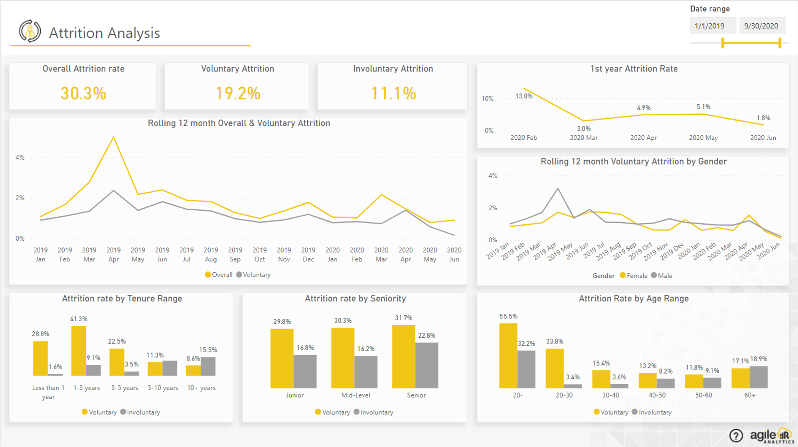
2.Layout
Attrition Analysis:
This layout shows the attrition rate and attrition trend. This information can provide insights into the level and trend of attrition within the organization.

Slide 17
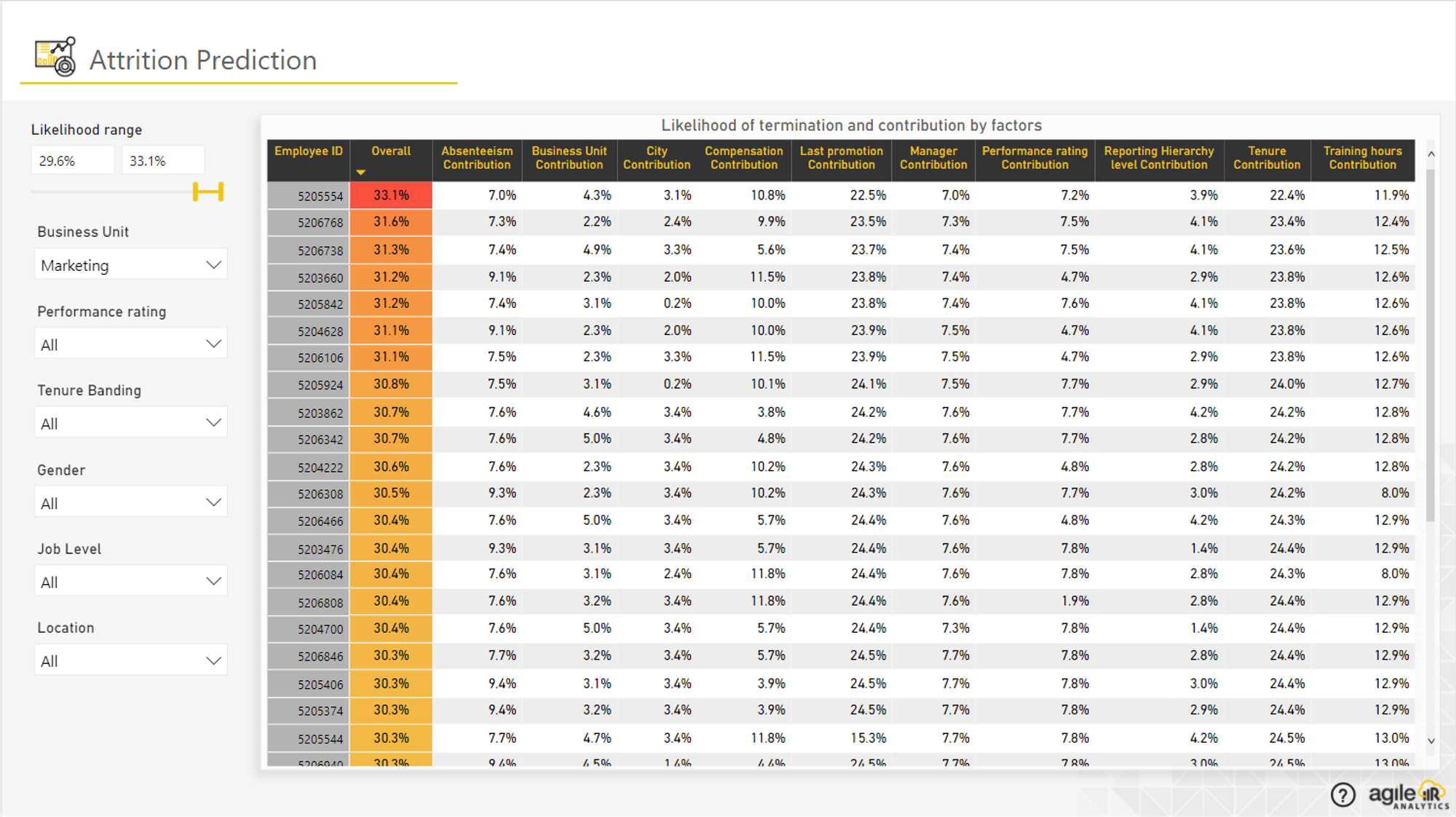
2.Layout
Attrition Prediction:
This layout shows the predicted attrition rate and the factors influencing attrition. This information can provide insights into the predicted level of attrition and the factors that may be influencing attrition.

Slide 18
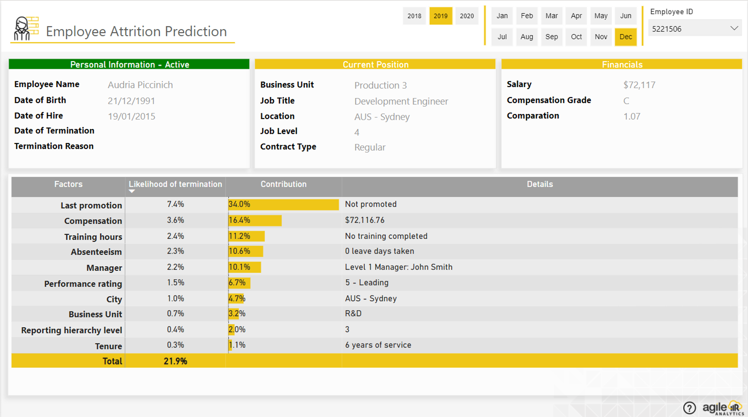
2.Layout
Employee Attrition:
This layout shows the list of employees who have left the organization and the reasons for their attrition. This information can provide insights into the employees who are leaving and their reasons for leaving.

Slide 19
3. Scope
Director: All layouts
Department: There is no right to see the Attrition prediction.
Manager: There is no right to see the prediction of Attrition and Attrition staff.
Employee: Can see: Summary, Diversity, Historical & Trend, Details of their own staff, Training, Leave Analysis, Absent of yourself.
HR Manager: There is no right to see the Attrition prediction.

